Slide 1
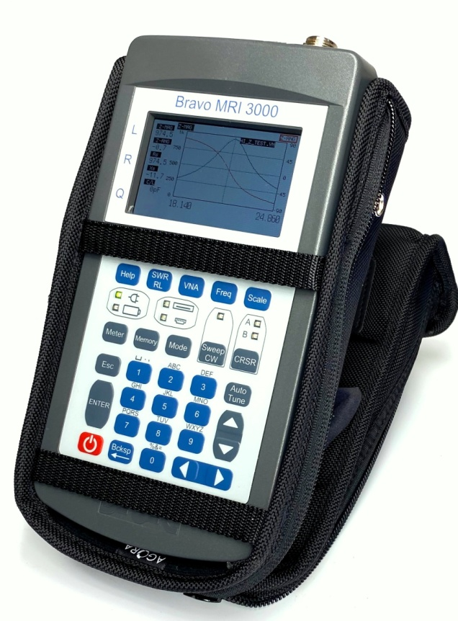

Liberator Series
Bravo MRI 3000 Analyzers
SWR, Return Loss, Resistance, Phase Angle, X, Q,
Equivalent Inductance and Capacitance

Slide 2
Liberator Series
Bravo MRI 3000 Measurements
100kHz to 450MHz
(Single Port)
Vector Network Analyzer
Z Magnitude Z Angle
Reactance Resistance
SWR Return Loss
Gamma Mag. Gamma Ang.
SWR Meter
Range: 1:1 to 1:100
Return Loss Meter
Range: 0 to -50dB

Slide 3






Liberator Series
Bravo MRI 3000 Included Accessories
N to BNC
adapter
AC Adapter
Terminators
Short & 50Ω
USB Cables
MRI PC Vision software
Operator Manual
PPT Training Presentation
MRI Analyzer

Slide 4
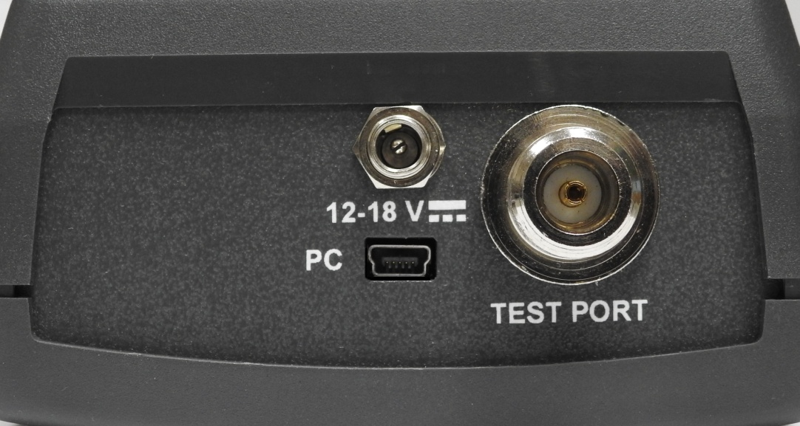
Case Top & Connectors
Charging Port
N -Test Port
USB Com Port
Bravo MRI 3000 Top End
TEST PORT

Slide 5
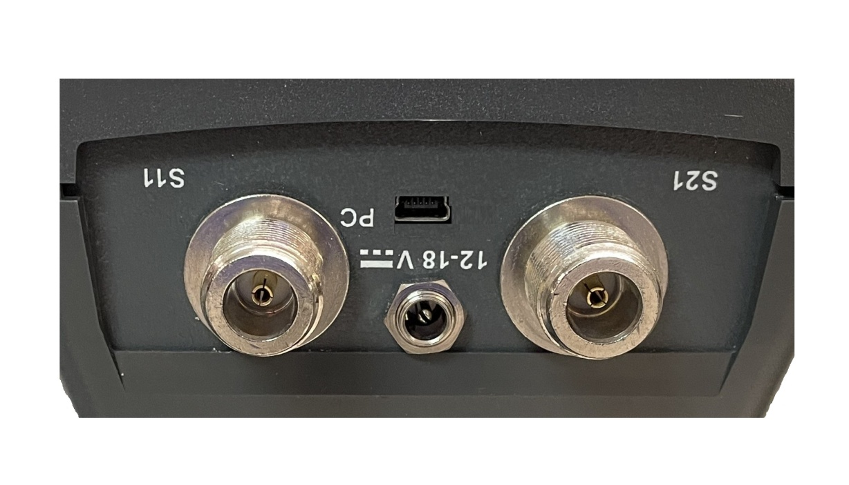
Case Top 2 Port & Connectors
N – S21 Test Port
Bravo MRI 3000 2 port Top End

Slide 6
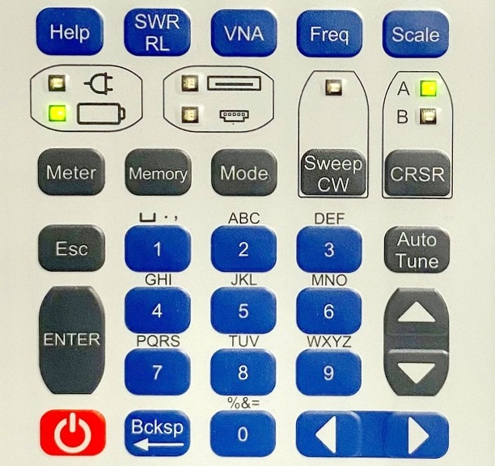
Features and Functions
Adjusts
parameter’s
scale range
Help over view & Context Sensitive
Help
Press 1 – Set
Start & End
Press 2 – Set
Center Freq.
& Bandwidth
Cycles between
SWR & Return
Loss
VNA mode

Slide 7
Features and Functions
Line power
Indicator
CW mode
Select
LED = activity
Battery Power Indicator
Cursors A
or B or both
select and
active LEDs
Memory access LED
Orange writing to memory
Green Reading from memory
PC Comms
LED

Slide 8
Features and Functions
1.Exits current
Operation
2.Cancel
cursors
Moves cursor to best
SWR’s or Return Loss
On the graph.
Instrument
setups menu
A/N keypad
Cycles alpha
characters then
Number
Repeat presses
cycles from
Alpha to number
or special
character Bcksp erases character
Saving and
Recalling Tests
Saves named test and parameter
changes
Menu Vert.
Cursor & Meas.
Screen
parameter
selection
Options selection
Short Press – Saves named test or setup and exits
Long Press – Forced Power Down
Cursor A & B controls &
data entry digit position

Slide 9
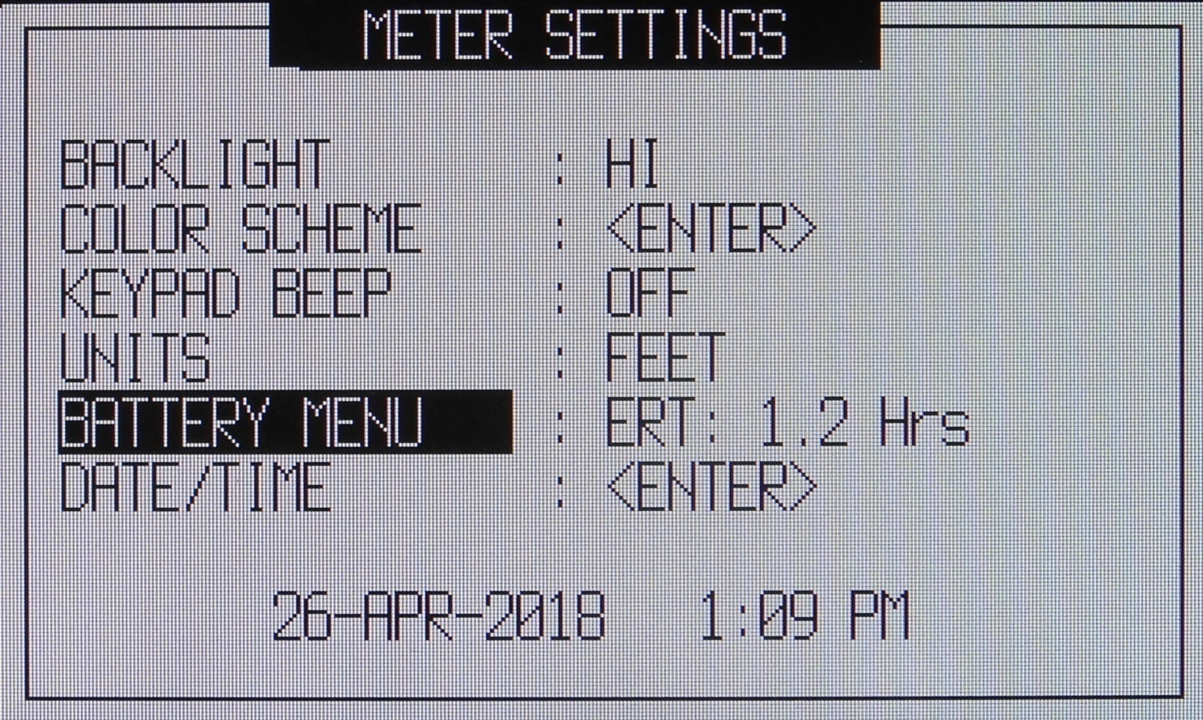




Meter Menu / Settings
Use to
select
vertical
menu
items
(LOW, MED, HI)
For <ENTER>
to sub-menu
Use to select horizontal options
Exit and Save changes

Slide 10
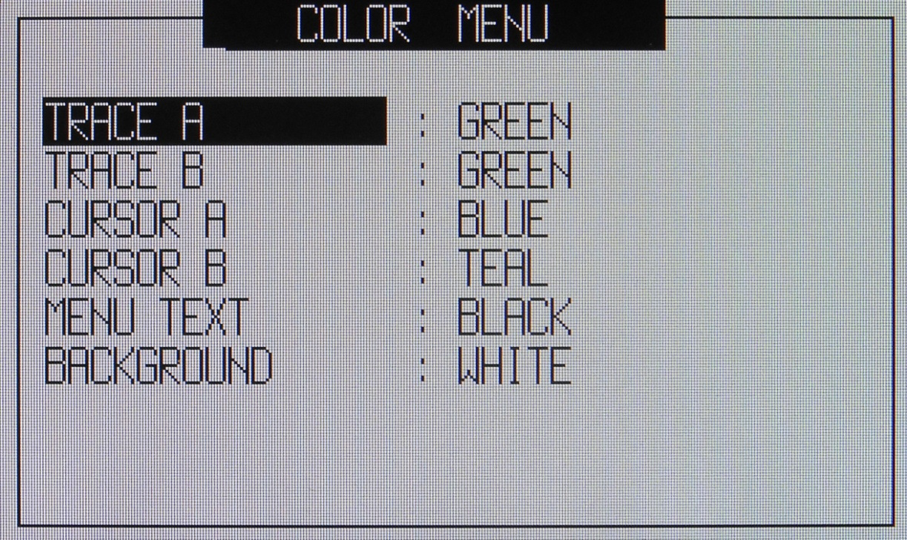
Meter Menu / Color
Color Palette:
Teal
Green
Orange
Blue
Black
Grey
Tan
Red
Dk Red
Violet
Steel
Silver
Cyan
White
NOTE: Background color locks out using same color for text
Yellow

Slide 11
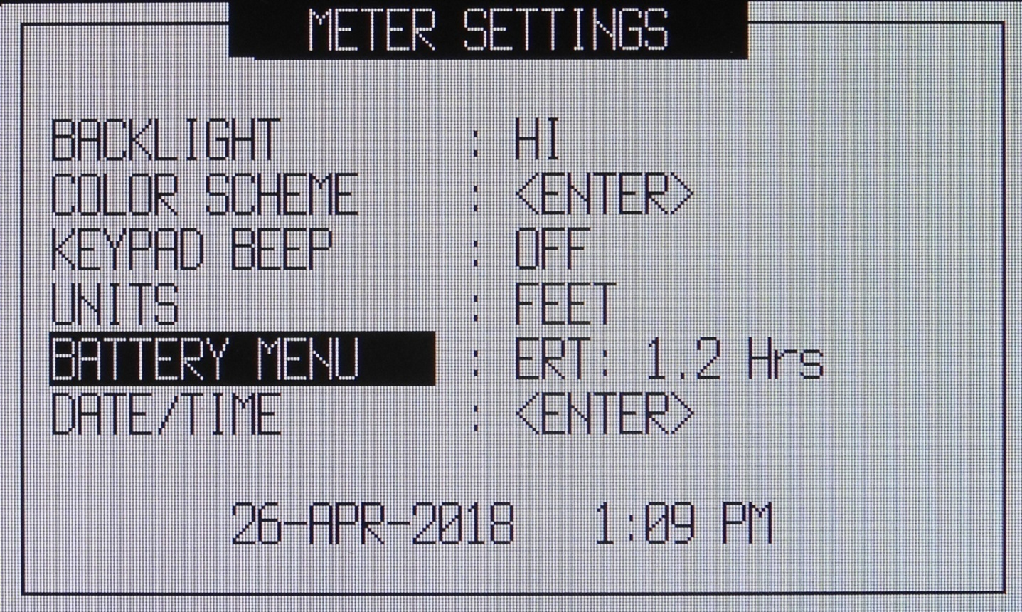
Meter Menu / Settings
(ON)
Use to select horizontal options

Slide 12
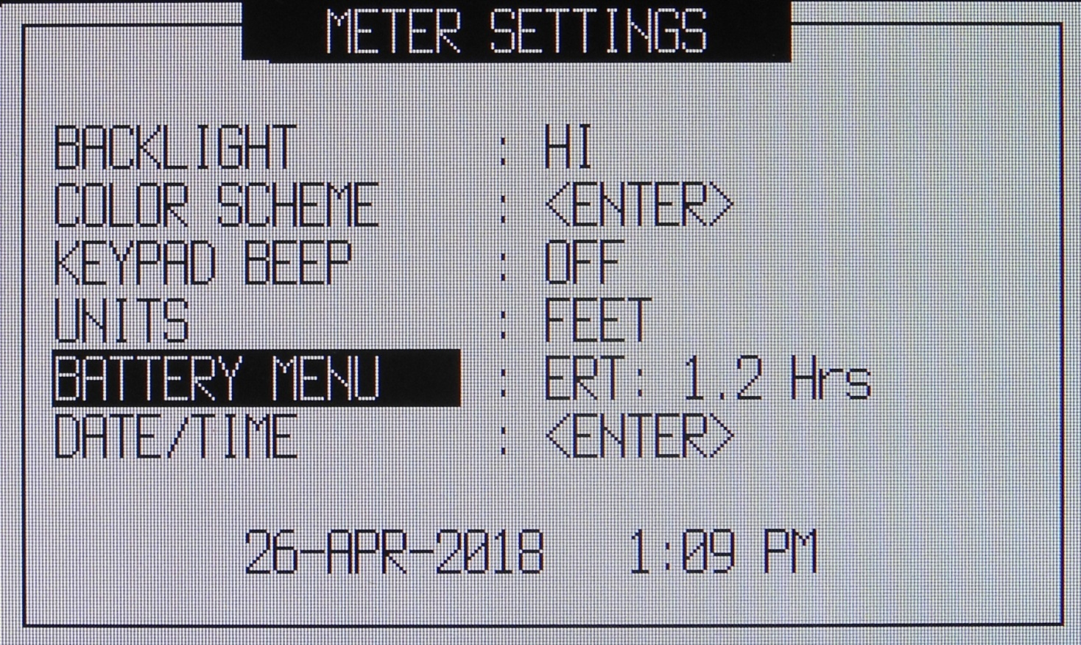
Meter Menu
(METERS)
Use to select horizontal options

Slide 13
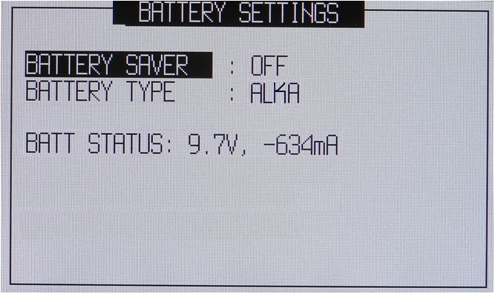
Meter Menu / Battery
ON=Powers down 5 minutes after last key is pressed
Battery Type can be set for Alkaline, Rechargeable, or None.
Battery Voltage indicator. Alkalines can run down to 7v, rechargables to 8v.
Battery current indicator. Increases as the batteries run down.

Slide 14
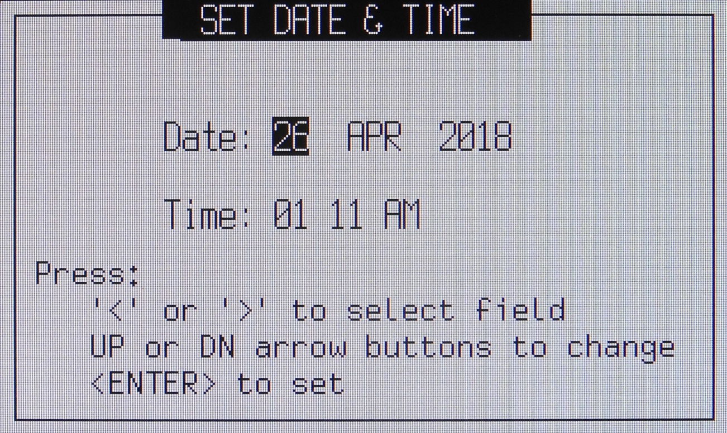
Meter Menu Date & Time
To select field
PM
To change the Setting
To save and exit
to Meter Menu

Slide 15

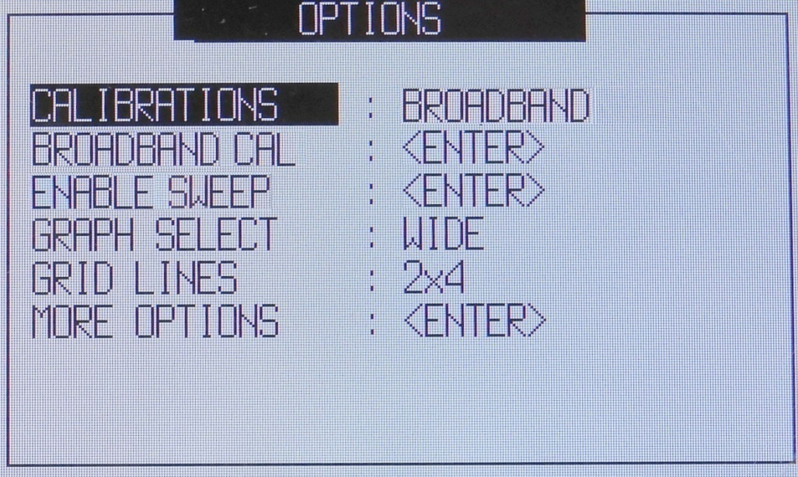
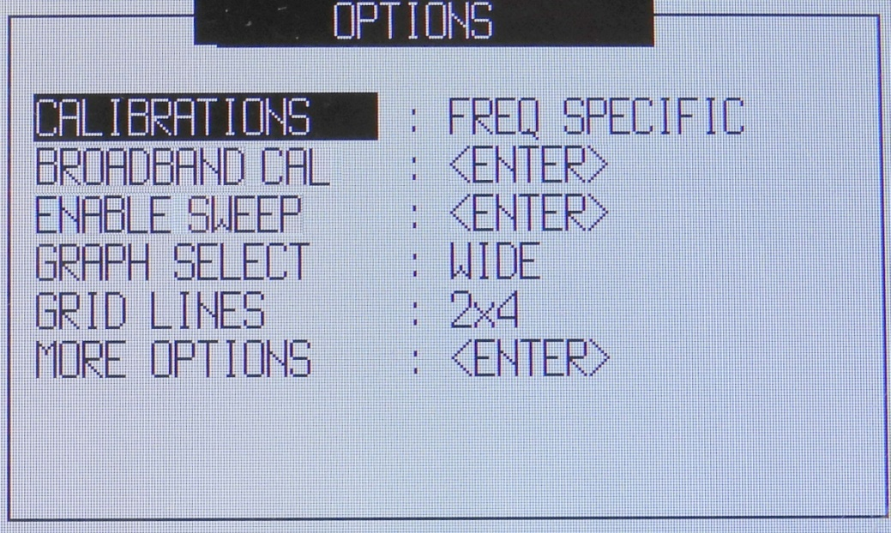
Mode Menu Calibration
Frequency Specific Calibration is performed with any frequency selection or adjustment of the Start, Stop, Center Frequency or Span. The advantage of Frequency Specific Calibration is it provides the maximum accuracy possible by the Site Analyzer.
Broadband is a calibration that is done one time using the Site Analyzer’s entire frequency range 100KHz to 450MHz and saved for use with any shorter frequency ranges selected for use

Slide 16

Mode Menu: Broadband Calibration & Enable Sweep
ENABLE SWEEP: Should the unit stop sweeping, the sweep can be re-enabled by selecting this item, and pressing ENTER.
BROADBAND CAL: Selecting this option will start the Broadband Calibration process. Broadband calibration is used when it is undesirable to have to calibrate the unit each time the frequency is changed. It will display a series of calibration screens prompting the user to attach the Open, Short, and Load Terminators. The Open prompt can use the open end of the test lead or adapter. Attaching an Open Terminator is optional, but recommended for most consistent results.

Slide 17


Mode Menu: Graph and Grid Lines Select
GRAPH SELECT: Pressing with this menu item selected will switch between WIDE and NARROW graph formats. WIDE format will display more points on the chart. Narrow format has fewer points, but uses the large format digital display for measurements at center frequency.
GRID LINES: Pressing Will select the gridline format for the screen. Selections are 2X2, 2X4, and 2X5.
MORE OPTIONS: Pressing <ENTER> Will select the next menu of options for: SYSTEM Z₀ and RLC MODEL.

Slide 18

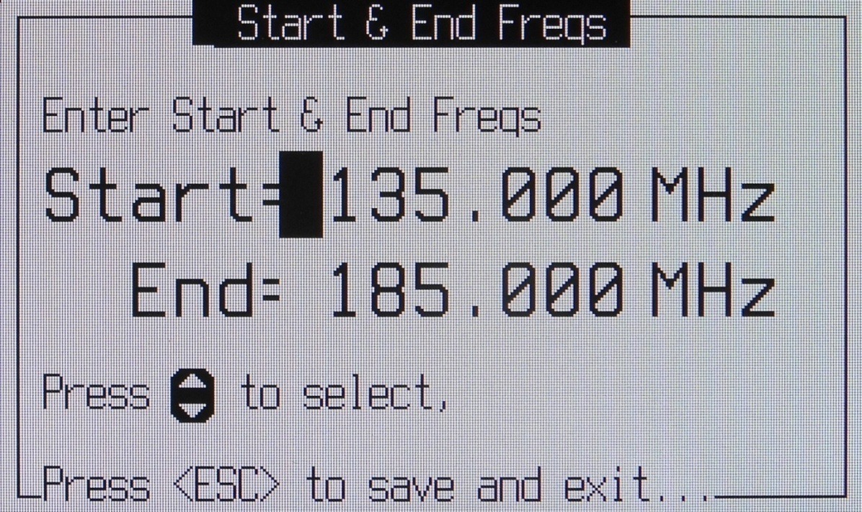

Frequency Selection
First Press
Alternates cursor
between Start &
End Frequencies
Moves cursor
Between digit
positions
Exits to Calibration
Screens

Slide 19
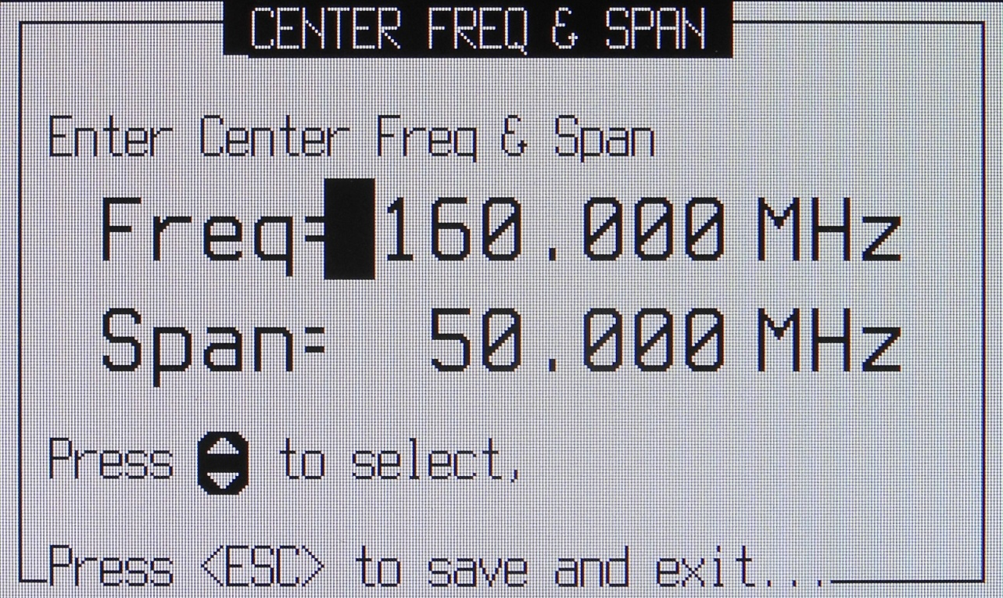
Frequency Selection
Second Press
Alternates cursor
between Start &
End Frequencies
Moves cursor
Between digit
positions
Exits to Calibration
Screens

Slide 20
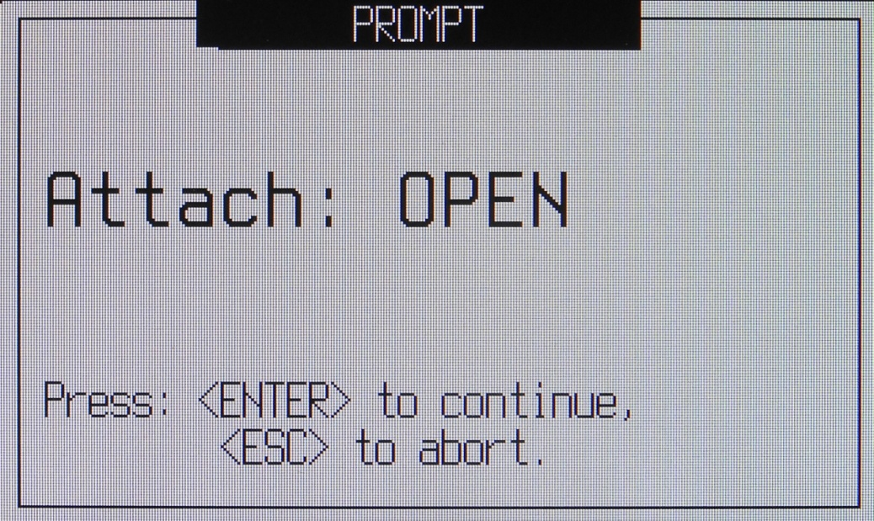
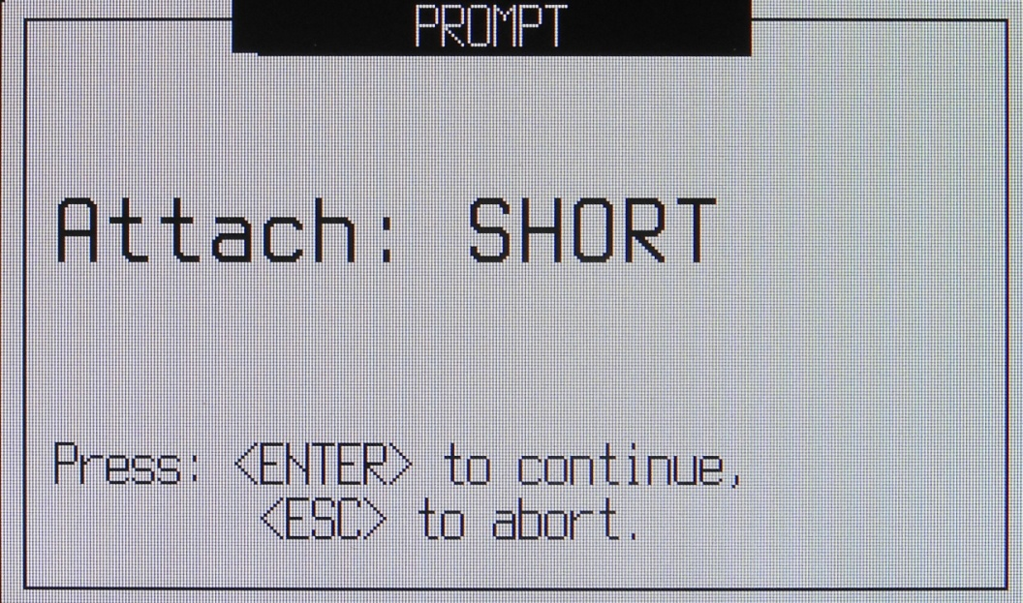
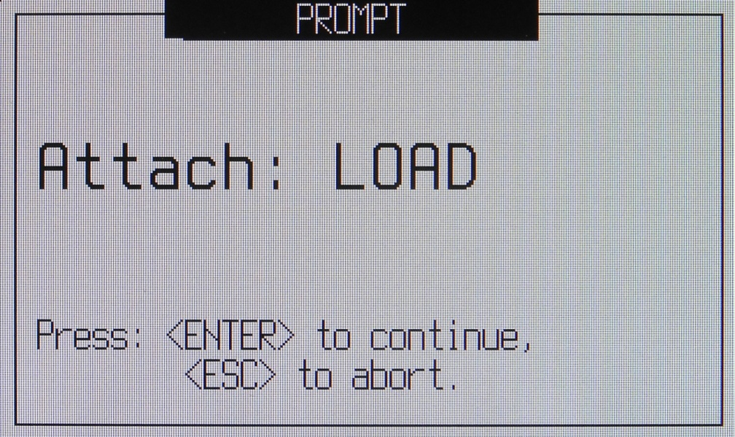
Calibration Sequence
<ESC> Goes to un-calibrated measurement screen

Slide 21
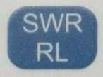
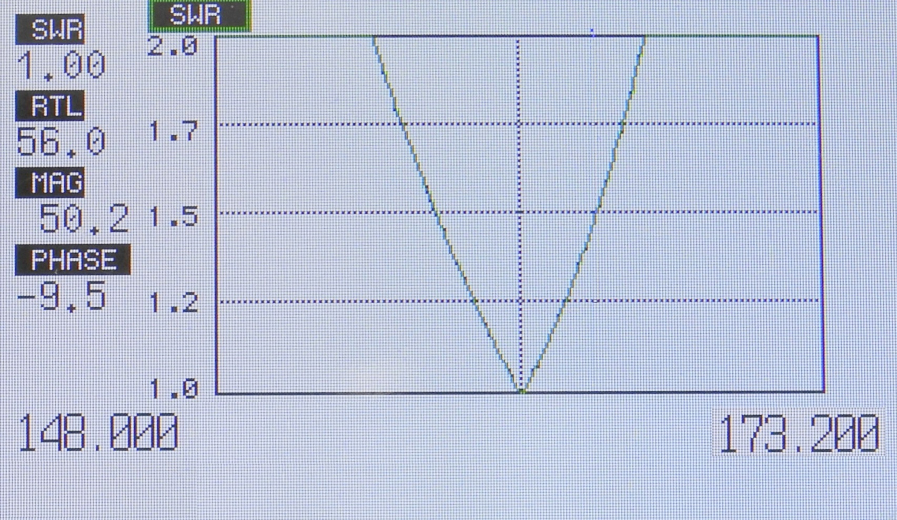
SWR & Return Loss Screen
Wide Format
Press

Slide 22
SWR & Return Loss Screen
Cursors Off.
Start Frequency End Frequency

Slide 23
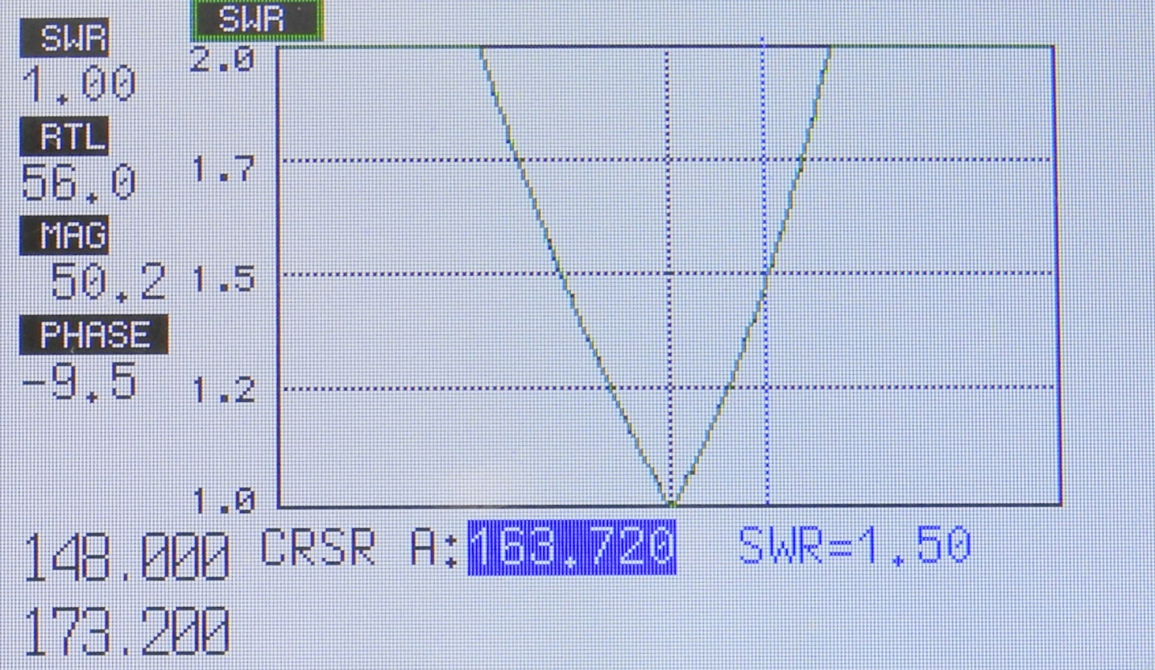

SWR Screen Cursors ON
CRSR Key Enables
Left/Right Arrow key Moves Cursor
Start
Frequency
End Frequency
Cursor data

Slide 24
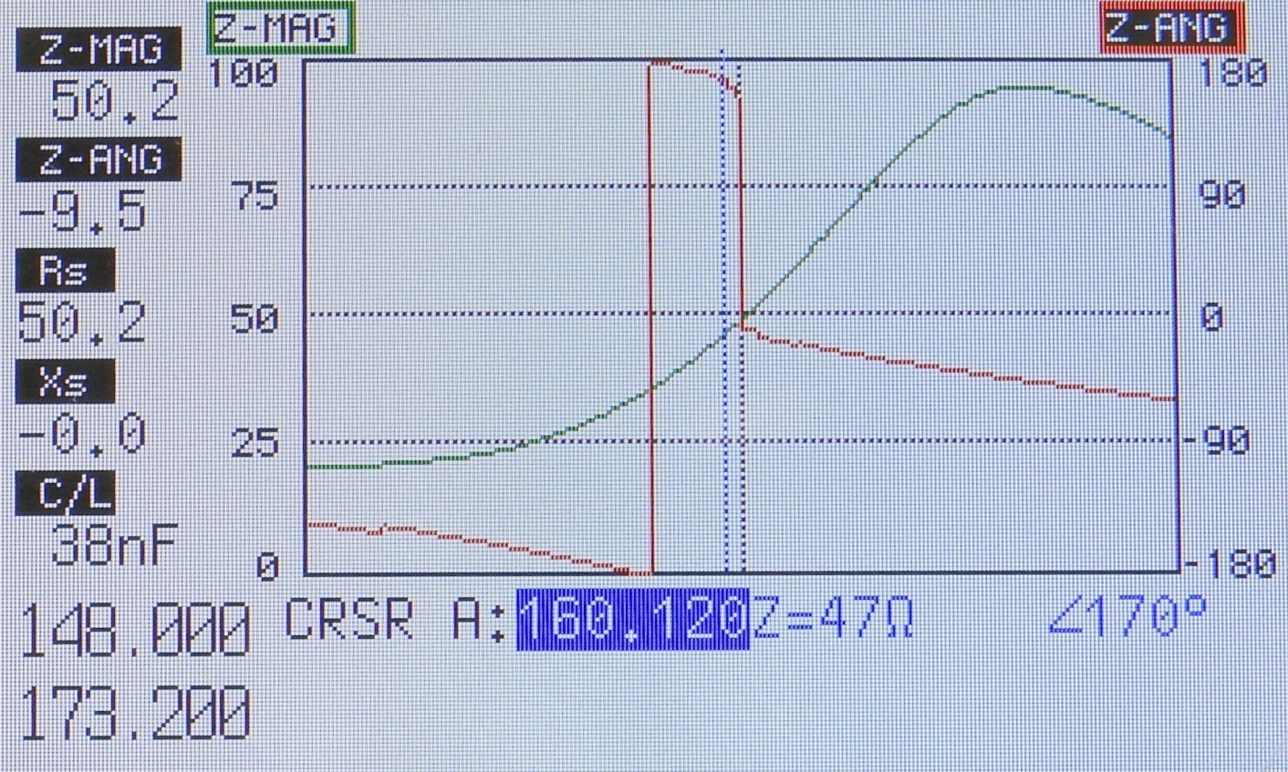

Wide Format Scale Select
Up Arrow button selects left or right scale
E
Scale key select the scales range.
Text
All scales, on all measurement screens work this way.

Slide 25
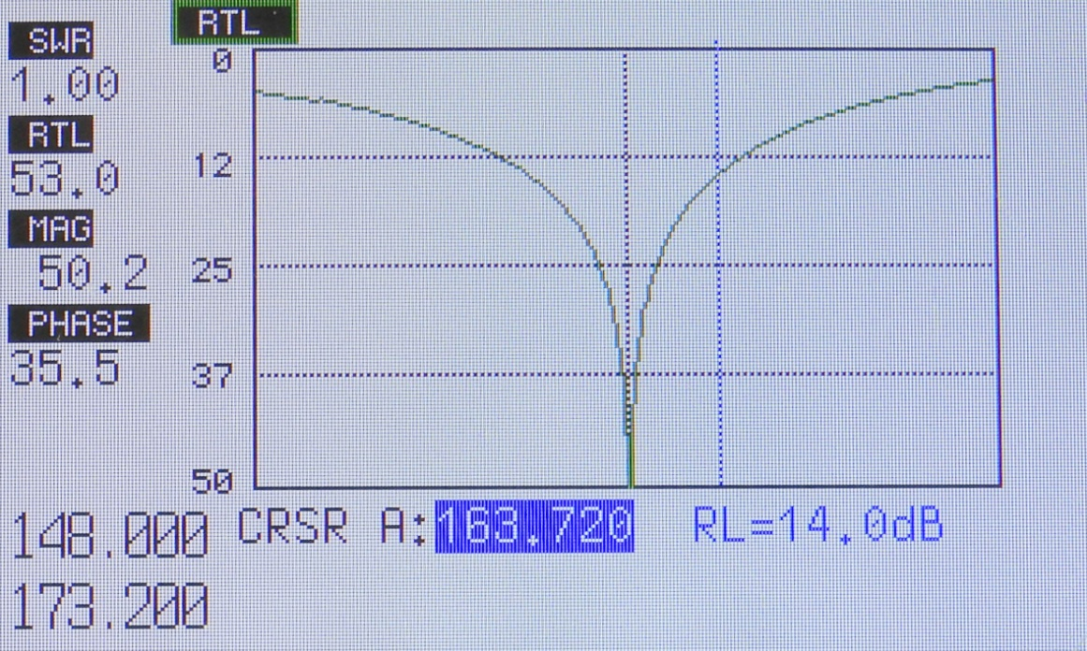
Wide Format Sidebar
Return Loss & SWR
Text
SWR
Text
Return Loss
The sidebar displays measurements at center frequency (f₀)
Impedance Magnitude (|Z|)
Text
Text
Impedance Angle
Text
This sidebar is the same for both SWR and Return Loss screens…

Slide 26

Wide Format Sidebar
VNA Mode
Impedance Magnitude (|Z|)
Text
Text
Impedance Angle
The sidebar displays measurements at center frequency (f₀).
Text
Resistance
Text
Reactance
Text
Capacitance /
Inductance
Text
The Capacitance / Inductance is determined by the RLC Setting…

Slide 27
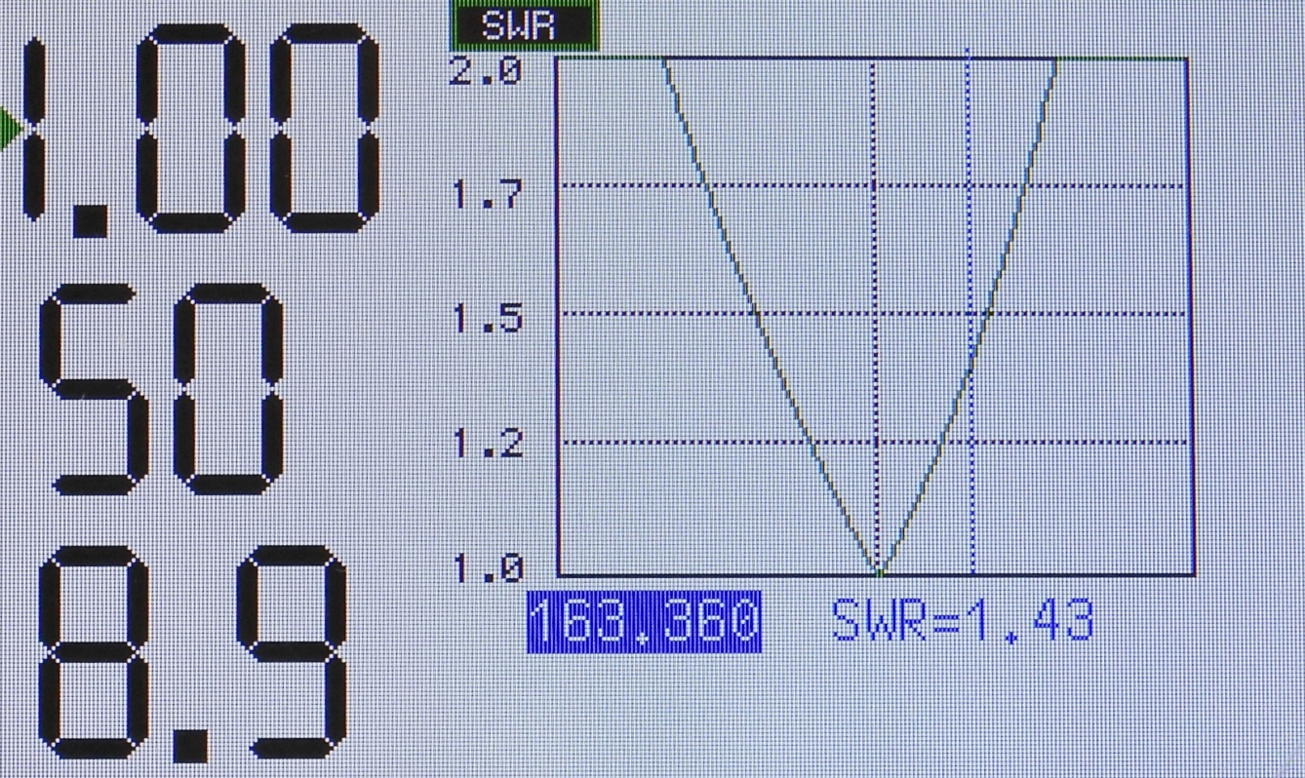

Narrow Format Screen
SWR
Text
Top indicator is always SWR
Text
Middle is always Return Loss
The sidebar displays measurements at center frequency (f₀).
Text
Bottom indicator is always circuit Q
Cursors work the same way
As Wide format with
Text
Circuit ‘Q’ is only displayed if there is sufficient bandwidth to calculate it.

Slide 28
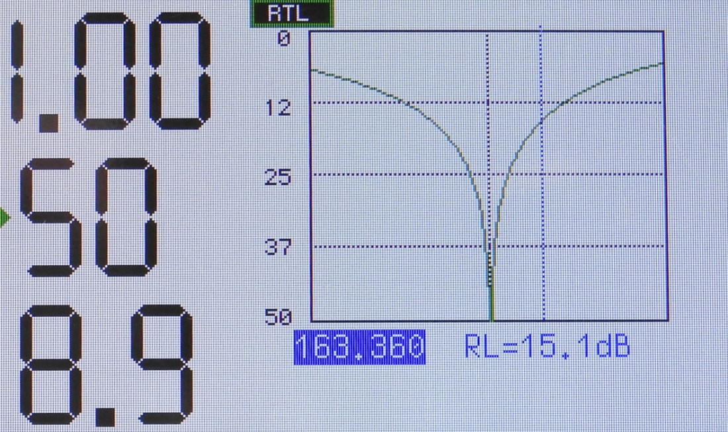
Narrow Format Screen
Return Loss
Text
When Return Loss is selected, this indicator will come on.
Text
Everything else is works the same as for SWR, except now Return Loss is plotted on the graph.

Slide 29
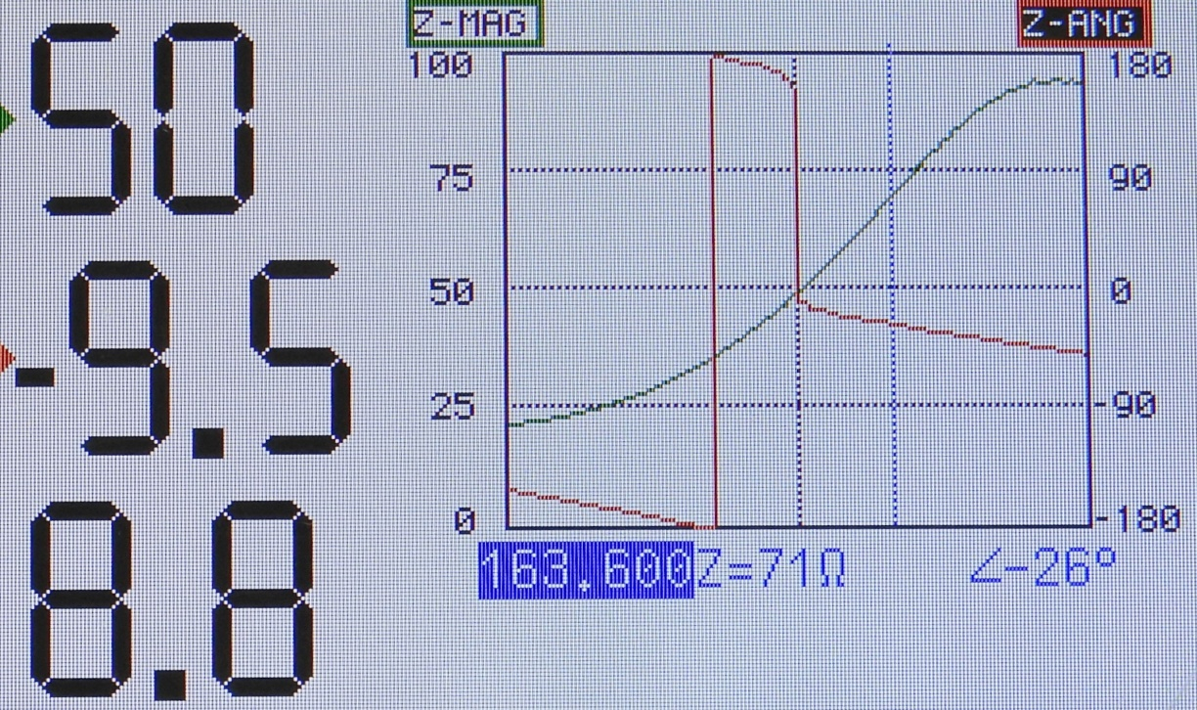
Narrow Format Screen
VNA Mode
Text
Top indicator is always the LEFT Trace
Text
Middle is always the RIGHT trace.
Text
Bottom indicator is always circuit Q
NOTE: Circuit ‘Q’ is only displayed if the Z-Mag trace is displayed (either side).
Text

Slide 30

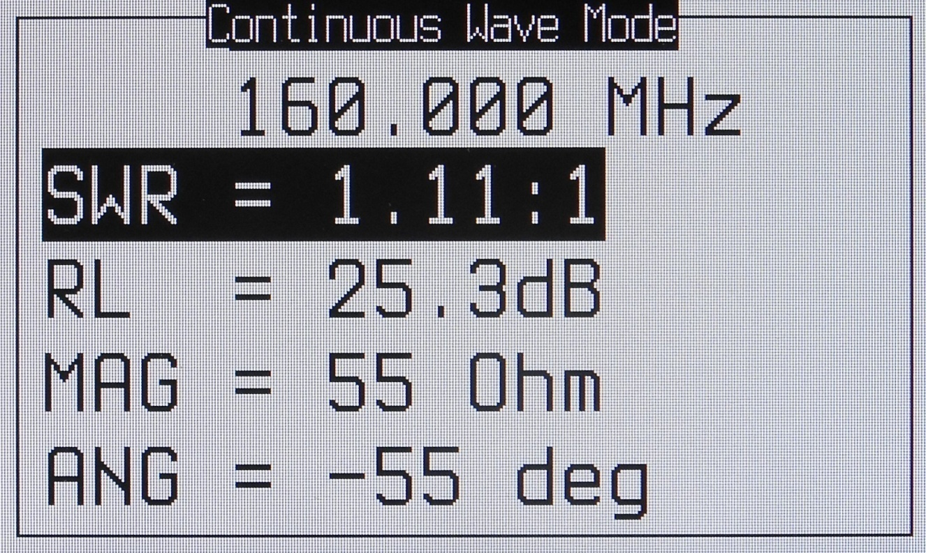
Continuous Wave Screen
Press for
Continuous
Wave mode
LED
indicates
it’s active
Scroll to
additional
meas.
parameters
CW mode is useful for adjusting tuned circuits.

Slide 31
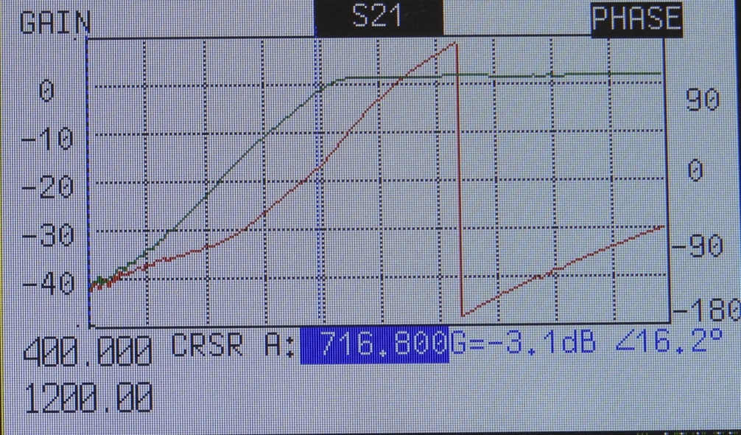
S21 Measurement Screen
Up arrow Cycles between
measurement parameters cursor
Left side is always GAIN
Press Enter to turn phase OFF/ON
Press Scale to select the range (2dB to 60dB)
Press Frequency to enter new sweep range

Slide 32
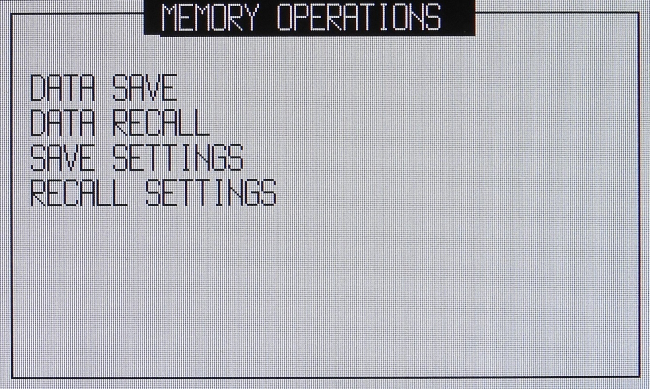
Memory Operations
50 Test results (instrument setups) can be named and saved

Slide 33
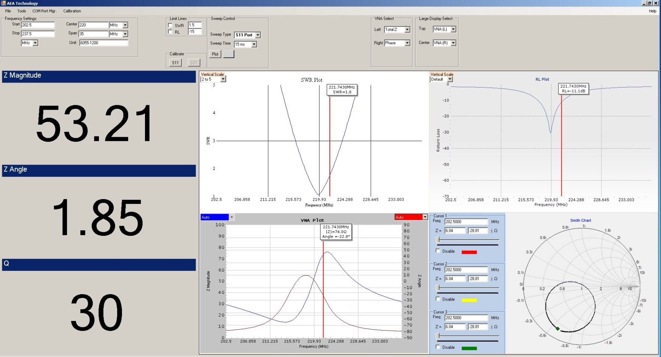
Site Analyzer PC Vision
S11 Analysis

Slide 34
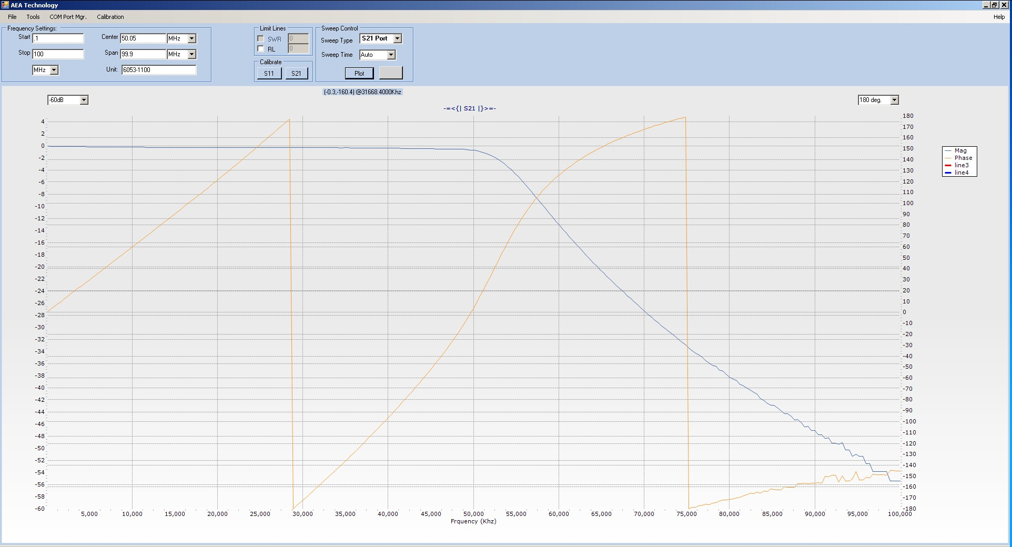
Site Analyzer PC Vision
S21 Filter Analysis

Slide 35
•
Liberator Series
MRI – 3000 Summary
SWR, RL and VNA (S11 and S21)
Wide frequency span – 100kHz to 450MHz (.7T to 10T)
Measurements Using any Reference Impedance (Z₀)
“Autotune” One-button locates coil center frequency
2kΩ Max |Z| (with Z₀ = 50Ω)
50 Test and setups in Internal Storage
Color QVGA Backlit Display
Economical, rugged, and light weight “Belt Friendly”
All new Site Analyzer PC Vision software

Slide 36
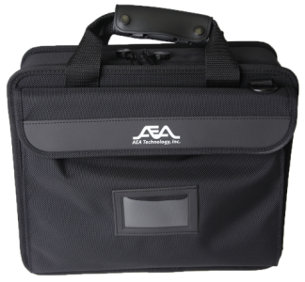
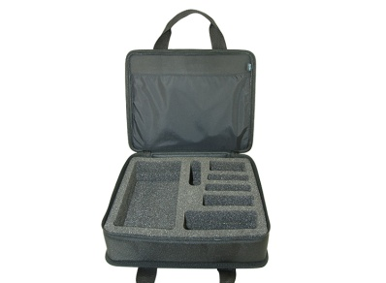
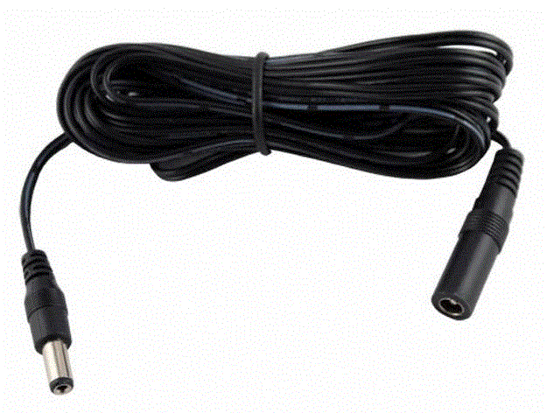
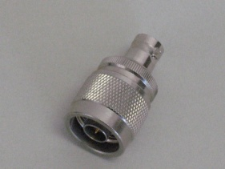
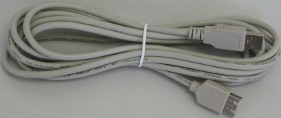
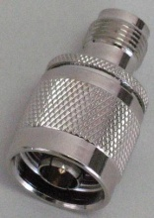
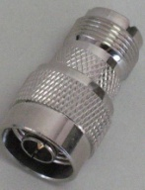
MRI-3000 Order Options
N to TNC Adapter | 0070-1134
N to SO239 (UHF) Adapter | 0070-1139
N to SMA Adapters and Terminators Set | 6025-0260
N type male 3 Way Termination Set: Open, Short and 50 Ω | 6025-0270
BNC Coax Test lead, 6ft (2m) P/N | 0070-1500
DC Power Extension Cable | 0070-1200
USB Cable, Extension | 0070-1210
Soft Carrying Case | 6015-1002
Certificate of Calibration MRI-3000 Analyzer | 6050-0700
Certificate of Calibration MRI-3000 Analyzer with before & after data | 6050-0710

